Slide 1

Iteration 1 Presentation
By Rebecca Nashed, David Rademacher, and Samuel Terwilliger

Slide 2
Project Plan
Project Description
Spamfoo is a helpful Discord bot which will interpret user queries in the form of math equations and return solutions for those equations in the form of images. As this project develops, the functionality of Spamfoo could potentially be expanded to satisfy user feedback.
Project Vision
To provide students with an easily accessible and intuitive math assistant.

Slide 3
Specification
Could Have
Example Questions
Stylistic linguistic patterns to encourage user engagement
Won’t Have
Image Input
Must Have
Text Input
Image Output
Internet Query
Should Have
Help Commands

Slide 4
Risks
Time Management and Scheduling
Probability: 90%
Effect: 3 hrs
RE: 90% * 3 = 2.7 hrs
Limited Experience
Probability: 80%
Effect: 3 hrs
RE: 80% * 3 = 2.4 hrs

Slide 5




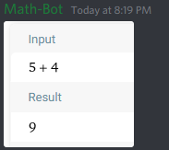
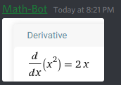


Design
Ideal Cases
Failed Cases

Slide 6
Code and Tests
Project structure
Server location
Required libraries
Modularity
Test Generation
Automate queries
Beta test cohorts

Slide 7
Customers and Users
Usage-dependent payment tiers
Distribute across multiple host machines

Slide 8
Q&A

Slide 9
References and Links
Code and Document Repository
https://github.com/banditsbeware/ooproject

